Slide 1
Maverick Health Policy Q1 2025 Update
April 3, 2025
Copyright © 2024 Maverick Health Policy, LLC. All rights reserved.

Slide 2
Agenda
Overview
1
Federal Government Reinvention
Deregulatory Agenda
HHS Reorganization and Downsizing
Executive Order Highlights: Make America Healthy Again, Price Transparency
Congressional Priorities
2
State Momentum
AI
Prior Authorization
Data Privacy
3
Increased Private Sector Activity
Self-Regulation
Other Industry Updates (e.g., payers, providers, digital health, etc.)

Slide 3
MyMaverick Subscription Service
Stay Informed: Your solution for health policy and market news with actionable insights
MyMaverick is a subscription service that provides straightforward analysis on complex health policy changes
MyMaverick's Newest Feature:
Weekly Guest Blog Posts
Hear from leading experts across the healthcare ecosystem, offering valuable perspectives and expertise.
The website and weekly newsletter highlight policy implications for short- and long-term business strategy
Interested in being a Guest Blogger? Or know someone who would like to be?
Email us at:
info@maverickhealthpolicy.com

Slide 4
Q1 2025 | Key Themes
Federal Government Reinvention | State Impacts | Private Sector Activity

Slide 5
Federal Government Reinvention
Deregulatory Agenda
HHS Reorganization
Healthcare Leadership
Executive Order Highlights

Slide 6
Deregulation Agenda: Workforce Shrinking and New Policy Slows
1
2
3
Downsized Workforce
Layoffs and voluntary resignation programs
Credit freezes and a central database to review contracts and grant
Hiring freezes impact academic medical centers
Deregulation Agenda
Shrinking federal government and limits to rules & guidance documents (e.g., 10 for 1 Deregulation EO)
Uncertainty regarding future federal workforce needs
Timelines
Litigation will take time
Scale of impact from the prior 72 days will also take time to assess
President Trump’s healthcare leadership team is only beginning to take shape…
How will they navigate this new environment?

Slide 7
HHS Reorganization | Make America Healthy Again Transformation
HHS announced a dramatic restructuring of the agency with four major pillars:
Workforce
Reduction
Streamline
Functions
Combat Chronic Illness
Improve Patient Experience
Structural Changes | Workforce Reduction Details
Two New Offices New Assistant Secretary for Enforcement Office of Strategy One New Division New Administration for Healthy America
FDA
3,500 employees
CDC
2,400 employees
NIH
1,200 employees
CMS
300 employees

Slide 8
HHS Announcement | Operating Divisions
FORMER
Operating Divisions*
NEW
Operating Divisions*
CMS
Federal Insurance Programs
CDC
Public Health
FDA
Medical Devices, Pharma
NIH
Biomedical Research
ASPR
National Disaster, Emergency Response
HRSA
Grants and Other Research
AHRQ
Safety, Quality of Care Research
CMS
Federal Insurance Programs
CDC
Public Health
FDA
Medical Devices, Pharma
NIH
Biomedical Research
AHA
Coordinate care for low-income Americans
ASPR
Nat. Disaster, Emergency
HRSA
Grants, Other Research
OASH
Public Health, Research Coordination
SAMHSA
Mental health, Substance Abuse
ATSDR
Toxic Substances, Disease Registry
NIOSH
Occupational safety
Shifted to Office of Secretary:
AHRQ
Safety, Quality of Care Research
*Does not include all Operating Divisions

Slide 9
HHS Announcement | Office of Secretary
FORMER
Office of Secretary*
NEW
Office of Secretary*
ASTP / ONC
Certified Health IT
OCR
Anti-Discrimination and HIPAA
OIG
Enforcement
ASPE
Policy Development, Research
OGC
Legal
Support
ASTP / ONC
Certified Health IT
Asst. Sec. Enforce.
Combat Waste, Fraud, Abuse
OIG
Enforcement
Office of Strategy
Improve Federal Health Programs
OGC
Legal
Support
NCVHS
Data Standards
OCR
Enforce federal civil rights laws
AHRQ
Safety, Quality of Care Research
ASPE
High-level Policies
NCVHS
Data, Standards, Privacy
*Does not include all Offices

Slide 10
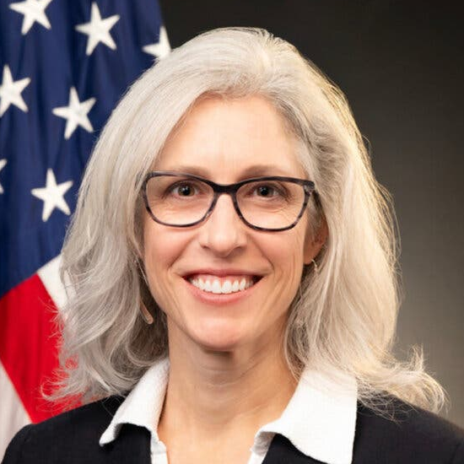
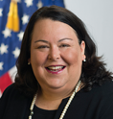
Trump Administration: Healthcare Leadership
HHS | CMS | Public Health Agencies
Secretary
Robert F. Kennedy Jr.
Administrator Nominee*
Mehmet Oz, MD
CDC Director*
Susan Monarez
Deputy Secretary*
Jim O’Neill
Chief Operating Officer
Kimberly Brandt
FDA Commissioner
Marty Makary, MD
CMMI
Abe Sutton
Medicare Chris Klomp
Medicaid Drew Snyder
CIO
Clark Minor
NIH Director
Jay Bhattacharya, MD
*Requires Senate confirmation

Slide 11
MAHA Commission: Addressing the Chronic Disease Epidemic
“Advise and assist the President” on how to best inform Americans of the chronic disease crisis
Data-driven report identifying the cause of childhood chronic disease, with global comparisons and education evaluations
Recommendations for restructuring the federal government's response to childhood chronic disease

Slide 12
Price Transparency: New EO reaffirms old policy stance, may lead to new requirements
Directs tri-agencies (HHS, DOL, Treasury) to issue new guidance or regulations on enforcement
Calls for new guidelines to make the data standardized and comparable
Prohibits hospitals and health plans from listing estimates

Slide 13
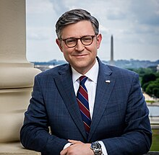
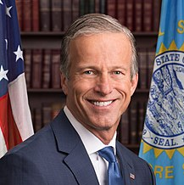
Congress Is Unlikely to Act on AI This Year
U.S. Senate
U.S. House
Senate Majority Leader
John Thune (R-SD)
House Speaker
Mike Johnson (R-LA)
E&C Chair Brett Guthrie (R-KY)
E&C Health Subcommittee Chair Buddy Carter (R-GA)
HELP Chair Bill Cassidy (R-LA)
SFC Chair Mike Crapo (R-ID)
Top Issues for Congress
Confirmations
Budget Reconciliation
High-Cost Programs

Slide 14
State Momentum
AI
Prior Authorization
Data Privacy

Slide 15
State Updates: States are busy regulating, where the federal government lags
AI
Prior Authorization
Data Privacy
States adopting "high-risk" bills modeled after Colorado, including:
MD, NE, NM
VA Governor vetoed AI legislation
Increase in health-specific legislation as well. Example:
Proposed NC bill requiring "licenses" for health AI chatbots
NAIC reviews prior authorization legislation in states
California bill on AI use for prior auth in effect
Other prior auth-related bills in:
FL, IL, IN, MN, RI, etc.
NY: Gov. Hochul signed New York Health Information Privacy Act into law
WA: First lawsuit using private right of action filed against Amazon
Activity in: VT, MD, VA, GA, IL, MA, etc.

Slide 16
Increased Private Sector Activity
Payers and Providers
Digital Health and Health IT

Slide 17
Industry Updates: "Traditional" Payers, Providers Adjusting to the New Normal
Payers
Acquisitions, antitrust lawsuits, prior authorization responses
Providers
Research funding cuts, federal funding uncertainties
Value-Based Care
Reimbursement models

Slide 18
Industry Updates: Health Technology Industry Emphasizing Self-Regulation
AI
Health IT
Digital Health
Updates from:
HIPAA Security Proposed rule pushback
Other updates from:
Updates from:

Slide 19
MyMaverick Subscription Service
Stay Informed: Your solution for health policy and market news with actionable insights
MyMaverick is a subscription service that provides straightforward analysis on complex health policy changes
The political landscape and policy changes creates uncertainty -- stay informed with MyMaverick
The website and weekly newsletter highlight policy implications for short- and long-term business strategy
Schedule a Demo with us Today:

Slide 20
Questions?
www.maverickhealthpolicy.com
julie.barnes@maverickhealthpolicy.com
paige.kobza@maverickhealthpolicy.com

