Slide 1

Maverick Health Policy Q2 Webinar
April 8, 2026
Copyright © 2025 Maverick Health Policy, LLC. All rights reserved.

Slide 2




Introductions
Julie Barnes
Founder and CEO
Maverick Health Policy
Brett Meeks
VP, Health Technology & AI Jeffrey Kimbell & Associates

Slide 3
Agenda
Overview
1
HHS Reorganization / Leaders Shaping Policy
2
The Trump Administration Plan
3
What to Watch

Slide 4
HHS Reorganization / Leaders Shaping Policy

Slide 5
1
Latest HHS Reorganization
*Does not include all Offices
Office of Secretary*
2025
Office of Secretary*
March 2026
ASTP / ONC
Dual Role: certify health IT; manage health IT, data, AI strategy
Office of CIO
Leads enterprise IT infrastructure
ONC
Sets standards for certified health IT, interoperability policy
Office of CIO
Lead data, tech, and AI strategy efforts
Chief Tech Officer
Chief AI Officer
Chief Tech Officer
Chief AI Officer
Chief Data Officer
Chief Data Officer
New Advisory Groups
2
3
FTC Healthcare Task Force
FTC Commissioner directed the creation of a task force to identify and lead coordinated enforcement and advocacy initiatives
HHS Healthcare Advisory Committee
Committee will advise Secretary Kennedy and Dr. Oz on how to improve Medicare, Medicaid, CHIP, and Marketplace financing and care delivery
5

Slide 6


Slide 7
The Trump Administration Plan:
AI Strategy

Slide 8

Trump Administration AI Strategy
The White House outlined its plans for a uniform federal framework to oversee AI
National AI Legislative Framework – March 2026
Federal Preemption through a “minimally burdensome” federal standard
State authority for traditional police powers, data center permitting
No new federal rulemaking body to oversee AI
State AI Executive Order – December 2025
DOJ AI Litigation Task Force
Secretary of Commerce evaluation of “onerous” state AI laws
  Deadline: March 11, 2026
FTC updated guidance on unfair trade practices
NIST AI Agent Standards Initiative – February 2026
Goal: Support interoperable and secure adoption of AI agents through industry-developed standards
Plans to announce research, guidelines, concept papers, and listening sessions
  Virtual workshops on sector-specific barriers to adoption: April 2026

Slide 9
Clinical AI | Request for Information
Over 7,000 stakeholders commented on how HHS can accelerate the adoption of AI in clinical care
COMMON CHALLENGES
1
2
3
Regulatory Authority
Clarify FDA and ONC jurisdiction (ACR, Paragon)
Map existing regulations to use cases to prevent duplication (Amazon)
Reimbursement & Coding
Create a new Medicare benefit category (AMA)
Move away from CPT codes (HIA)
Reclassify cost calculations (AHA, CTA)
Liability
Safe harbor protections for clinicians and developers (ATA Action)
Shift liability to deployers (AMA)
4
5
6
State-Led Activity
Establish federal framework (AHIP, CTA)
Targeted state law moratorium (HLC)
Federal sandboxes (Teladoc)
Post-Deployment
Shared infrastructure and federally-accessible datasets (Oracle)
Focus on evaluation in deployed settings (Amazon)
AI-Ready Datasets
Expand TEFCA and update info blocking rules to open AI development (HAIP)
Create a national patient registry (HLC)

Slide 10

FDA AI Activity to Watch
The agency must respond to key outstanding questions on drug development and AI regulation
AI Authority Report Due
The FDA was directed to provide a report to Congress by Feb. 10, 2026, assessing its existing authority to regulate AI/ML-enabled medical devices and Software as a Medical Device (SaMD)
Upcoming AI Drug Development Report Due
Lawmakers also directed the FDA to report, by May 2026, on the status of efforts to use AI in drug development
User Fee Reauthorization
AI in health care is likely to be included in the broader user fee reauthorization, which Congress must pass by Sept. 2027 and has historically served as a key vehicle for policy changes
Harrison.ai Citizen Petition
FDA denied the request for a streamlined approval for AI-powered diagnostic device manufacturers seeking additional device capability approvals under the 510(k) pathway

Slide 11
The Trump Administration Plan:
Reducing Health Care Costs

Slide 12
HHS Priorities are Influencing Midterm Messaging
Deregulation
Integrating Technology
Payment Reform
Removing barriers to incentivize technology adoption & support innovation
Ensuring patients can easily access and use their own data
Paying for care based on value, not time or volume
Cost Reduction

Slide 13
Connecting HHS’ Priorities with Reducing Health Care Costs
ONC HTI-5 Proposed Rule
FDA Updated Guidance for General Wellness: Low-Risk Devices and Clinical Decision Support (CDS) Software
Prioritizing Data Liquidity
Diagnostic Imaging Interoperability Standards
EHIgnite
Agentic AI
CRUSH RFI
CMS’s Innovation Center (CMMI) ACCESS Model
Medicare Advantage Risk Adjustment
Prior Authorization and Drug Pricing Reform
DEREGULATION
INTEGRATING TECHNOLOGY
PAYMENT REFORM

Slide 14
Deregulation | HTI-5 Proposed Rule
Commenters generally supported ONC's proposal to shift health IT certification to FHIR, but cautioned against substantially altering criteria before FHIR is mature
COMMENT LETTER KEY THEMES
1
2
3
4
5
Certification Criteria Removal
Strong support to retain care coordination, cybersecurity criteria
Removal shifts vendor vetting burden onto providers
FHIR Transition
Strong support of moving to FHIR
Warn against retiring existing criteria until FHIR is operationally ready
AI Transparency
Mixed opinions on whether to remove or retain the PDSI source attribution requirements
Information Blocking
Mixed opinions on whether to change information blocking exceptions
Information Blocking – Automated Access
General support but some concerns about downstream use of data via automated access
14

Slide 15
Deregulation | FDA Updated Guidance for Wearables & CDS
Updated guidance documents are intended to adapt regulations to contemporary technology realities to enable innovation at "Silicon Valley speed"
Non-Device Clinical Decision Support (CDS)
Wellness Devices
Description
Impact
  Defines wellness products as those that:
    Promote a general state of health; or
    Promote a healthy lifestyle to reduce the risk of / guide living with chronic conditions.
  Definitions: Clarifies criteria for non-device CDS
  Enforcement discretion: FDA will exercise enforcement discretion for CDS
  Provider usability: Should prioritize most important information; does not apply to critical tasks
Signals a risk-based approach to regulation
Decrease time and cost to market entry
May increase consumer health anxiety and confusion knowing what products to trust
Widens scope of non-device CDS
Softens transparency requirements in favor of usability
Reorients the importance of automation bias and impact of software dealing with time-critical tasks
15

Slide 16

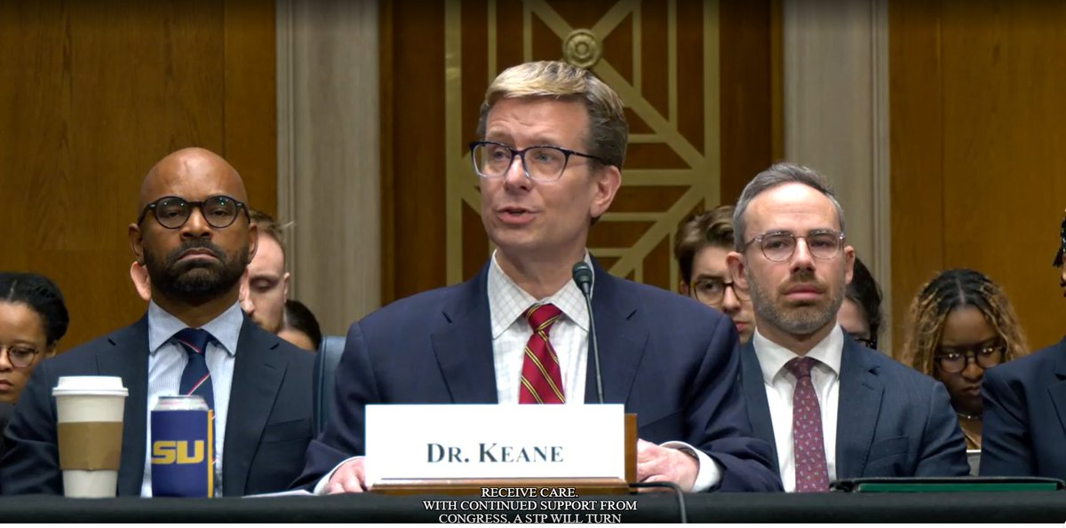
Integration of Technology | Prioritizing Data Liquidity
ONC messaging is centralizing around data liquidity – ensuring patients have access to records and information blocking is enforced
ONC Mission - Leverage technology to accelerate MAHA goals and improve affordability, access, patient outcomes
TEFCA – exchanged 500M records since launch
Information blocking – ONC issuing notices of potential nonconformance
My top priority is fostering greater data liquidity … so that patients and their clinicians are in the driver’s seat...Together, we can ensure that data is not a barrier, but a bridge, connecting patients to safer care, clinicians to better tools, and communities to a more resilient health system for years to come."

Slide 17
Integration of Technology | Expanding Interoperability
Recent ONC initiatives are designed to expand interoperability – improving access to both the type and usability of the data available
RFI: Diagnostic Imaging Interoperability Standards & Certification
"EHIgnite" Interoperability
Challenge
Description
Impact
  ONC RFI on potential certification criteria for diagnostic imaging standards
  Targets fragmented ecosystem: CD/DVD reliance, siloed images, limited patient API access
  Two phase challenge on patient tools and data filtering to improve how patient health records are made usable
    Bonus: use of "transparent, explainable" AI
  Phase 1: Applications open thru May 13
  Phase 2: Summer 2026 – Spring 2027
First time certification requirements could extend to imaging systems, not just EHRs
Could open market for certified imaging interoperability vendors
Increased access to diagnostic images
Up to nine $10K Phase 1 prizes, three Phase 2 prizes ($30K - $250K)
Winners could shape how EHI exports work in practice
May influence future certification expectations

Slide 18

Integration of Technology | Other CMS Initiatives
Recent CMS updates highlight how technology can be used to support modernization of the system
CMS Claims Attachment Final Rule
Proposal to require HIPAA-covered entities to electronically transmit claims attachments (i.e., clinical notes, lab results, imaging, etc.)
Must be Compliant by May 2028
CMS CRUSH RFI
Broadly scoped RFI on opportunities for CMS to leverage technology to identify and mitigate fraud, waste, and abuse in federal health programs
Comments were Due: March 30
Medicare App Library
Launched specifications for applications participating in the CMS Health Tech Ecosystem and be featured in the App Library
Official Launch Expected April 9
AI Tools for Medicare Modernization RFI
Identifying vendors with production-ready Medicare-specific AI/ML capabilities for healthcare decision support and call center automation
Comments were Due: March 31

Slide 19
What to Watch
Payment Reform, Integrating Technology, Other Considerations

Slide 20
What to Watch | Reimbursement and Funding
Health care reimbursement and funding continues to be in flux
MA Final Rules
Provider Payment Rules
Proposed HHS Budget
CMS released a final rule revising the CY27 MA and Medicare Prescription Part D programs on April 2
  Overhaul of Star Ratings
  Removed Health Equity Index
MA CY27 Rate Announcement
  Finalized a 2.48% increase, up from proposed 0.09%
  Finalized some updates to MA risk adjustment
SNF: Proposed a 2.4% rate increase, reduced quality measures, shortened data submission timeline
IP Rehab: Proposed a 2.4% rate increase, initiative therapies within 36 hrs of admission, etc.
IP Psych: Proposed a 2.3% rate increase, standardized assessment instrument, etc.
Hospice: Proposed a 2.4% rate increase for 2027, new scoring system, etc.
White House proposes 12% cut to federal health agencies in the 2027 budget request

Slide 21
What to Watch | Integrating Technology
Integrating technology continues to be a top priority for this administration
1
2
3
Health Tech Ecosystem | CMMI Models | Expected Rules
April 9: Official launch the Medicare App Library July 4: Health Tech Ecosystem one year mark National Provider Directory | ACCESS: Applications were due on April 1; launches on July 5 WISeR: Congressional and Industry stakeholder scrutiny | Final HIPAA Privacy Rule on care coordination expected to be released soon (proposed in Jan. ‘21) Proposed Prior Auth Standards for drugs No Surprises Act IDR
Honorable Mention: ARPA-H’s biosensor and pediatric cancer projects

Slide 22
What to Watch | Other Considerations
Midterm elections, major legal cases, and the partial government shutdown will continue to shape health policy in the near term
1
2
3
DHS Partial Shutdown
House–Senate disagreements over immigration enforcement funding continues
Leadership is now pursuing a two-track approach and a potential reconciliation package by June 1
Midterm Elections
RFK launches midterm travel push to reinforce MAHA support
The Trump White House counts RFK Jr. as a top surrogate
Key Lawsuits
Information Blocking
Antitrust (OhioHealth, New York-Pres)
Ghost Networks
No Surprises Act
DSH Payments
340B
Google-Meta social media addiction

Slide 23
Looking Ahead | What is Maverick Health Policy Watching?
Rollout of CMS Health Tech Initiatives
Information Blocking in the Courts
Care Delivery System Transformation
Mounting Financial Pressures
State vs. Federal AI Regulation

Slide 24
Questions?
www.maverickhealthpolicy.com
julie.barnes@maverickhealthpolicy.com

